Slide 1




LOAN RECOVERY MANAGEMENT
GROUP NUMBER-1
Department of BioSystems Technology
Faculty of Technology
General Sir John Kotelawala Defence University

Slide 2

OVERVIEW
This project focuses on developing a Loan Recovery Management System that helps organizations track, monitor, and improve loan repayment processes using automation and data-driven insights.
01

Slide 3
PROBLEM STATEMENT
Organizations dealing with loans often face challenges such as:
Difficulty tracking repayment dates
Manual calculation errors
Identifying customers who delay payments
Poor visibility of repayment behavior
Lack of automated grading or reporting
The system solves these issues by providing automated tracking, grading, and reporting.
02

Slide 4
PROJECT OBJECTIVES
Automate loan repayment tracking
Record customer, loan start, and loan completion details
Automatically calculate repayment duration
Grade customers based on repayment behavior
Identify risky or delayed customers
Provide simple reporting and history records
03

Slide 5
LIMITATIONS
System is admin-based, and only the administrator can view loan details
System is customised for Sri Lankan timezone, so it may not work correctly in other timezones
Uses Sri Lankan currency (LKR) only
No automated SMS or email notifications (planned for future enhancement)
No integration with external banking or financial system
04

Slide 6
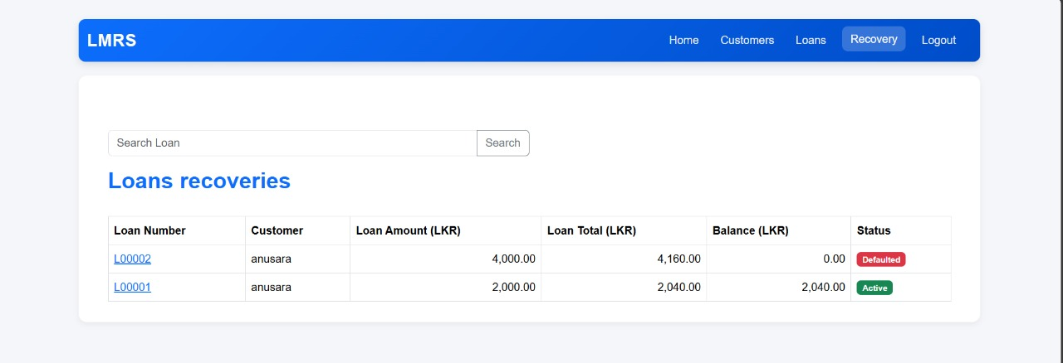
CHALLENGES & SOLUTIONS
Ensuring Atomic Updates During Recovery Recording
Issue: Recovery entry and loan balance updates needed to occur simultaneously to prevent inconsistent data.
Solution: Implemented database transactions to ensure that payment insertion and balance update execute as a single atomic operation.
05

Slide 7

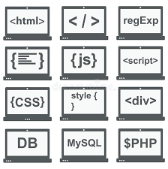
TOOLS AND TECHNOLOGIES USED
Front-end / Interface: HTML, CSS, Java Script
Frame Work : Laravel 12
Back-end : PHP, Java ,Date difference calculations and grading algorithm
Database: MySQL ,tableplus
Software / IDE: VS Code, Figma , Tableplus
06

Slide 8
CONCLUSION
The Loan Recovery Management System simplifies and strengthens loan repayment tracking.
Enhances accuracy, reduces risk
A valuable tool for any organization dealing with loans.
07

Slide 9
THANK YOU
10

